Slide 1
Functions

Slide 2

Introduction to Functions
Concept:
A function is a group of statements that exists within a program for the purpose of performing a specific task.
3-2
Notes:
2

Slide 3
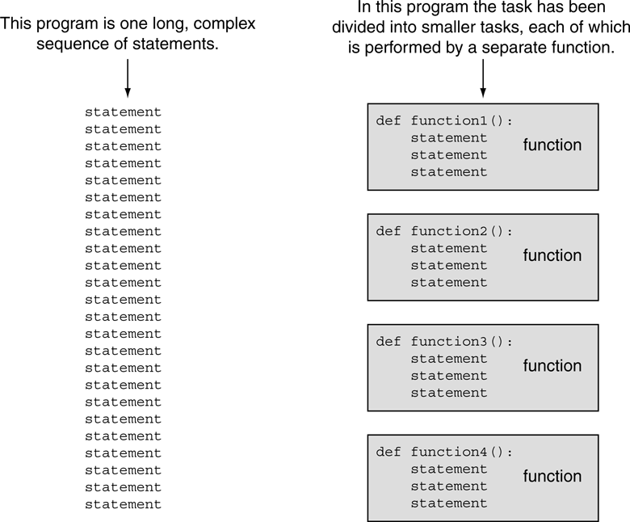
Introduction to Functions
Divide and Conquer
Using functions to divide and conquer a large task

Slide 4
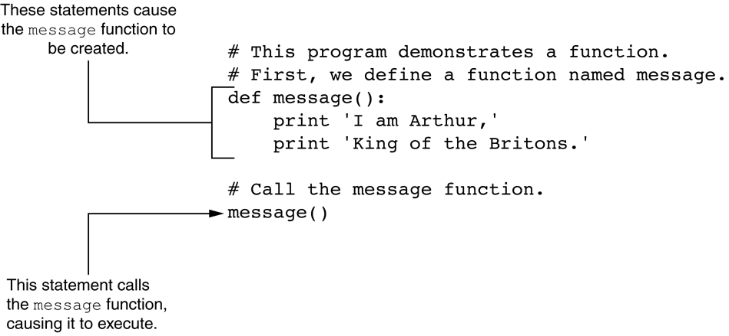
Defining and Calling a Function

Slide 5
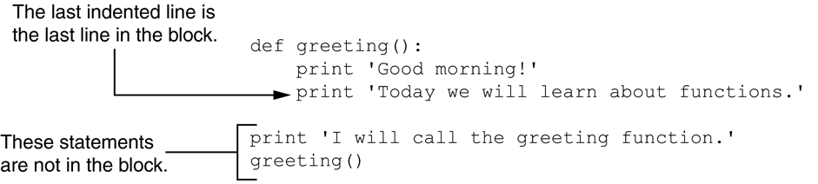
Defining and Calling a Function
Indentation in Python
All of the statements in a block are indented

Slide 6

Local Variables
Concept:
A local variable is created inside a function and cannot be accessed by statements that are outside the function. Different functions can have local variables with the same names because the functions cannot see each others’ local variables.

Slide 7
Local Variables
Scope and Local Variables
A local variable’s scope is the function in which the variable is created

Slide 8
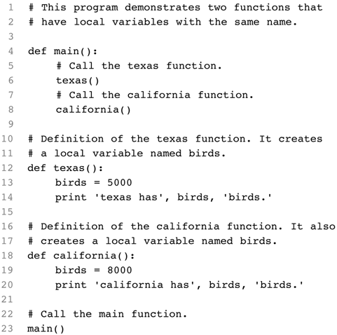
Local Variables
Note the use of a function called main that drives the application
Definition of main() – it drives the application by calling the other functions
Calls main()

Slide 9

Passing Arguments to Functions
Concept:
An argument is any piece of data that is passed into a function when the function is called. A parameter is a variable that receives an argument that is passed into a function.

Slide 10
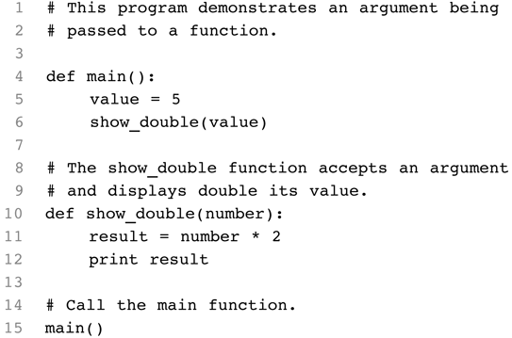
Passing Arguments to Functions

Slide 11
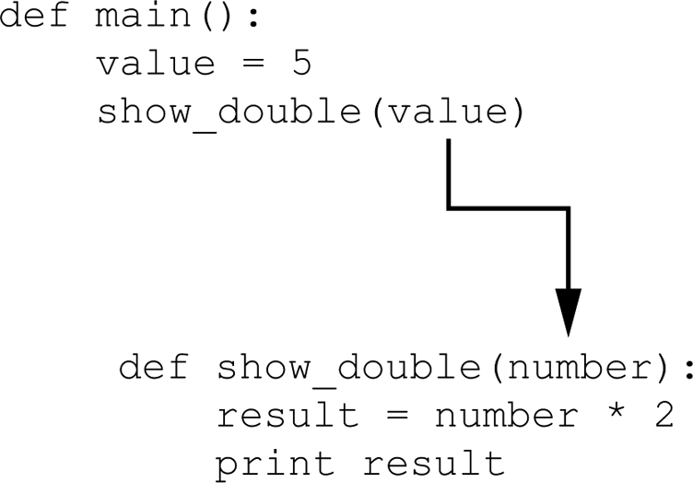
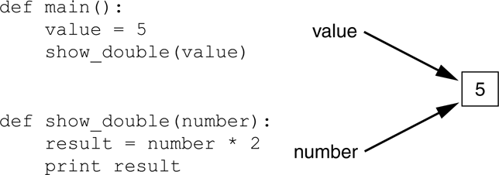
Passing Arguments to Functions
The value variable is passed as an argument
The value variable and the number parameter reference the same value

Slide 12
Passing Arguments to Functions
Parameter Variable Scope
A parameter variable’s scope is the function in which the parameter is used.
Inside the function, the parameter variable can be accessed, but no statement outside the function can access it.

Slide 13
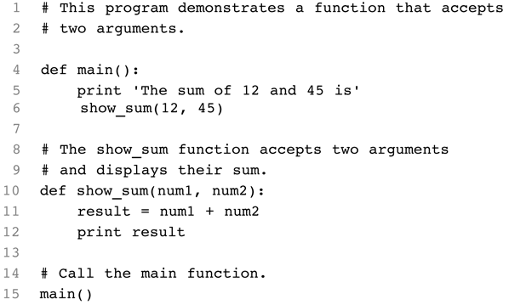
Passing Arguments to Functions
Passing Multiple Arguments

Slide 14
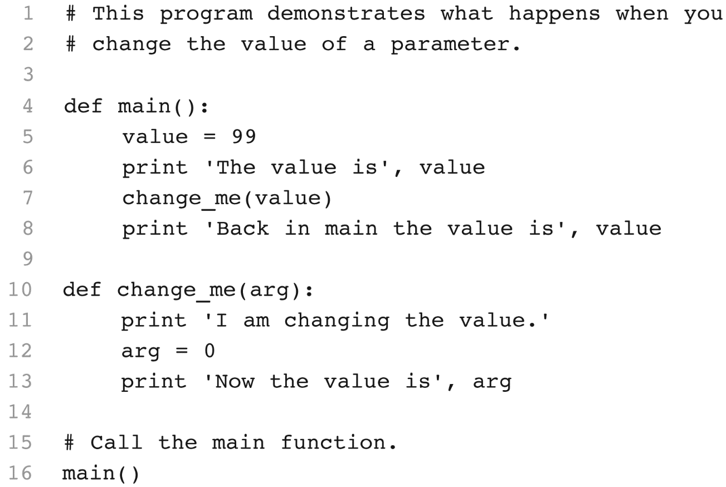
Passing Arguments to Functions
Making Changes to Parameters
Note – no side effect: the value of variable value stays the same
(change_me.py)
Output
The value is 99
I am changing the value.
Now the value is 0
Back in main the value is 99

Slide 15
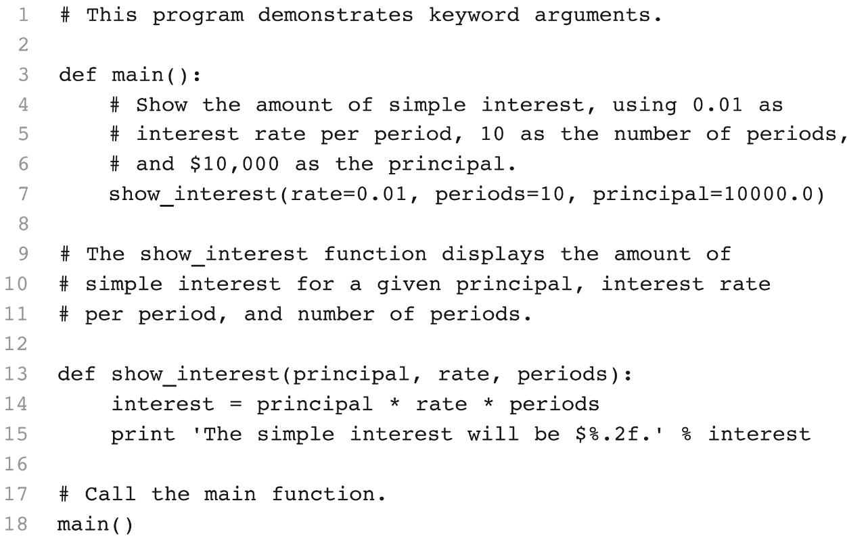
Passing Arguments to Functions
Keyword Arguments
Specifies which parameter the argument should be passed into. Its position in the function call does not matter.

Slide 16

Global Variables and Global Constants
Concept:
A global variable is accessible to all the functions in a program file.

Slide 17
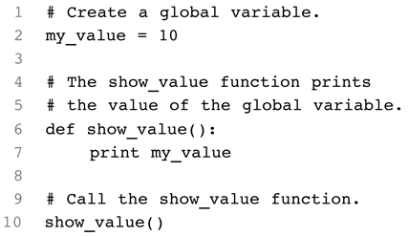
Global Variables and Global Constants

Slide 18
Global Variables and Global Constants
Restrict the use of global variables for the following reasons:
Global variables make debugging difficult
Functions that use global variables are usually dependent on those variables.
Global variables make a program hard to understand.

Slide 19

Introduction to Value-Returning Functions
Concept:
A value-returning function is a function that returns a value back to the part of the program that called it. Python, as well as most other programming languages, provides a library of prewritten functions that perform commonly needed tasks. These libraries typically contain a function that generates random numbers.
6-19
Notes:
19

Slide 20
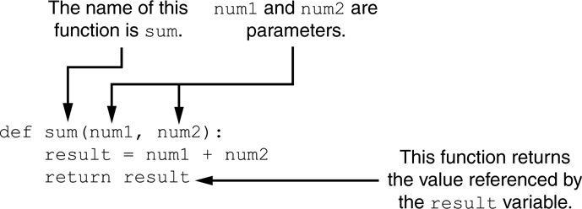
Writing Your Own Value-Returning Functions
def function_name():
statement
statement
etc.
return expression
Parts of the function
6-20
Notes:
20

Slide 21
Writing Your Own Value-Returning Functions
Returning Strings
def get_name():
# Get the user’s name and return the name
name = input(‘Enter your name:’)
return name
Returning Boolean Values
def is_current_year(year):
if (year == 2019):
return True
else:
return False
6-21
Notes:
21

Slide 22
Writing Your Own Value-Returning Functions
Returning Multiple Values
first_name, last_name = get_name()
def get_name():
# Get the user’s first and last name.
first = input(‘Enter your first name: ‘)
last = input(‘Enter your last name: ‘)
# Return both names.
return first, last
6-22
Notes:
22

Slide 23
MicroBit Built-in Functions
See “microbit-quick-reference.pdf on the LMS
button_a and button_b
.is_pressed()
.was_pressed()
.get_presses()
.reset_presses()
display
.scroll(string, delay=400)
.show(image, delay=0, wait=True, loop=False, clear=False)
.show(iterable, delay=400, wait=True, loop=False, clear=False)
.set_pixel(x, y, brightness)
.clear()
brightness = display.get_pixel(x, y)
pin0..20 (not 17 or 18)
.write_digital(value)
.write_analog(value) # 0..1023
.set_analog_period(int)
.set_analog_period_microseconds(int)
.is_touched()
value = pinX.read_analog()
value = pinX.read_digital()
temperature
temperature()
image = Image('90009:09090:00900:09090:90009:')
.width()
.height()
.set_pixel(x, y, value)
.brightness = get_pixel(x, y)
.shift_left(n)
.shift_right(n)
.shift_up(n)
.shift_down(n)
accelerometer
.get_x()
.get_y()
.get_z()
.get_values()
.current_gesture()
.is_gesture(“name”)
.was_gesture(“name”)
.get_gestures()
.reset_gestures()
Gestures: up, down, left, right, face up, face down, freefall, 3g, 6g, 8g, shake
compass
.calibrate()
.heading()
.get_field_strength()
.is_calibrated()
.clear_calibration()

Slide 24
Exercises

Slide 25
Button Inputs
Button functions are Boolean functions, i.e. they will return True or False:
button_a.is_pressed()
button_b.is_pressed()
If you’re pressing the button it returns True, otherwise it returns False
e.g. -> https://microbit-micropython.readthedocs.io/en/latest/tutorials/buttons.html#handling-an-event
from microbit import *
while True:
if button_a.is_pressed():
display.show(Image.HAPPY)
elif button_b.is_pressed():
display.show(Image.SAD)

Slide 26
Touch Inputs
The numbered pins on your BBC micro:bit can detect when you touch one of them with your finger
You must touch the GND with one hand and touch the numbered pin with the other
Each pin serves as a touch input and its state can be read the is_touched() function, e.g. for pin0:
pin0.is_touched()
from microbit import *
while True:
if pin0.is_touched():
display.show(Image.SURPRISED)
sleep(2000)
else:
display.show(Image.ASLEEP)

Slide 27
Exercises
Exercise: Read from the temp sensor and scroll the temp on the LEDs when button “A” is pressed
Hint – the temperature() function will give you the current temp
Bonus – convert the temp from C to F by writing your own function
Exercise: Attach your Micro:Bit to a sensor, e.g. the LED or sound sensor, then have the sensor turn on when you touch pin0 and turn off when you touch pin1
from microbit import *
while True:
if button_a.is_pressed():
display.show(Image.HAPPY)
elif button_b.is_pressed():
display.show(Image.SAD)
elif pin0.is_touched():
display.show(Image.SURPRISED)

Slide 28
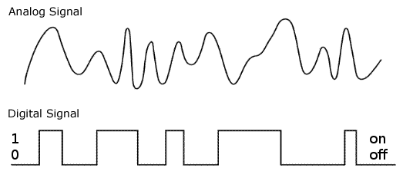
Sensors – Analog or Digital?
Analog signals are continuously varying while digital signals are binary (high or low)
Some sensors are analog, some are digital (some can even output both)
Some output data, others received input from our code
We need to know which it is to be able to interact with the sensor correctly in our Python code!
https://microbit-micropython.readthedocs.io/en/latest/pin.html
# DIGITAL PINS
read_digital()
write_digital(value)
# ANALOG PINS
read_analog()
write_analog(value)

Slide 29
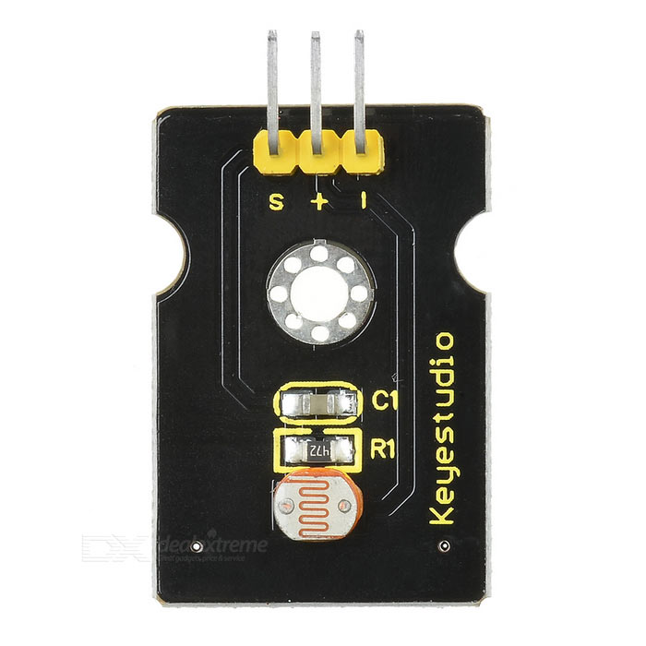
Photocell Sensor
Read the docs to learn how to connect!
https://wiki.keyestudio.com/Ks0028_keyestudio_Photocell_Sensor
Note the specifications:
Interface Type: analog
Working Voltage: 5V
For analog devices that output data, we READ the data using the function:
pin0.read_analog()

Slide 30
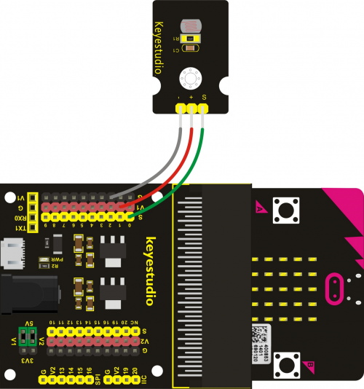
Photocell + Plotter Example
Wire the photocell as shown, with the signal line connected to pin0
Flash the below code to your Microbit:
Open the plotter!
from microbit import *
while True:
value = pin0.read_analog()
print((value,))
sleep(100)

Slide 31
For next week
Do readings
Reflection essay #1 due on LMS
Practice connecting and working with one new sensor from the kit
First – look up the documentation to see how to wire it!
Next – based on whether it is analog or digital or provides input or output, write simple code to interact with it
We’ll share our findings next week in class

